Slide 1
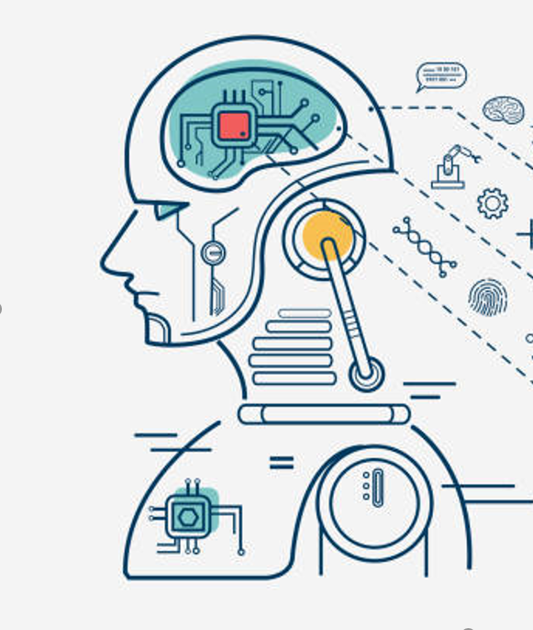
Introduction to Machine Learning
Arsalan Anwar ©

Slide 2
“Artificial Intelligence, deep learning, machine learning - whatever you’re doing if you don’t understand it – learn it. Because otherwise, you’re going to be a dinosaur within 3 years.”
- Mark Cuban
Arsalan Anwar ©

Slide 3
Roadmap
Introduction
Example Demo
Problem Exploration
Implementation/ Execution
Arsalan Anwar ©

Slide 4
Introduction
Arsalan Anwar ©

Slide 5
What is Machine Learning?
“The ability of systems/ machines to automatically learn and improve from experience without being explicitly programmed”
Arsalan Anwar ©

Slide 6
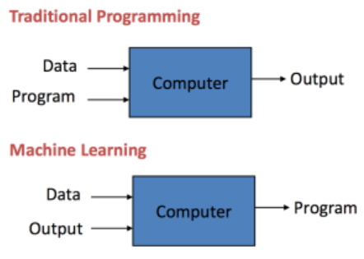
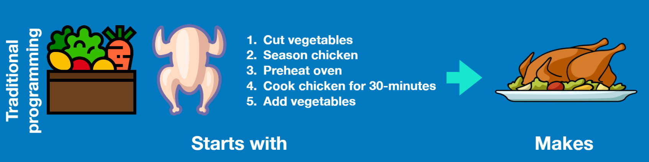
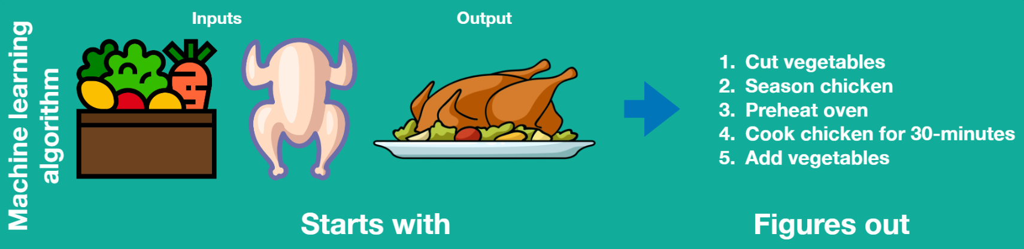
Traditional Programming vs Machine Learning
Arsalan Anwar ©

Slide 7
Why Machine Learning
Simple, we cannot think of all the rules!
1. Long set of rules, hence traditional programming fails
2. Continuous changing environments, hence machine learning models can adapt to new environments without being explicitly programmed
3. Discovery of insights from a large amount of data
Arsalan Anwar ©

Slide 8
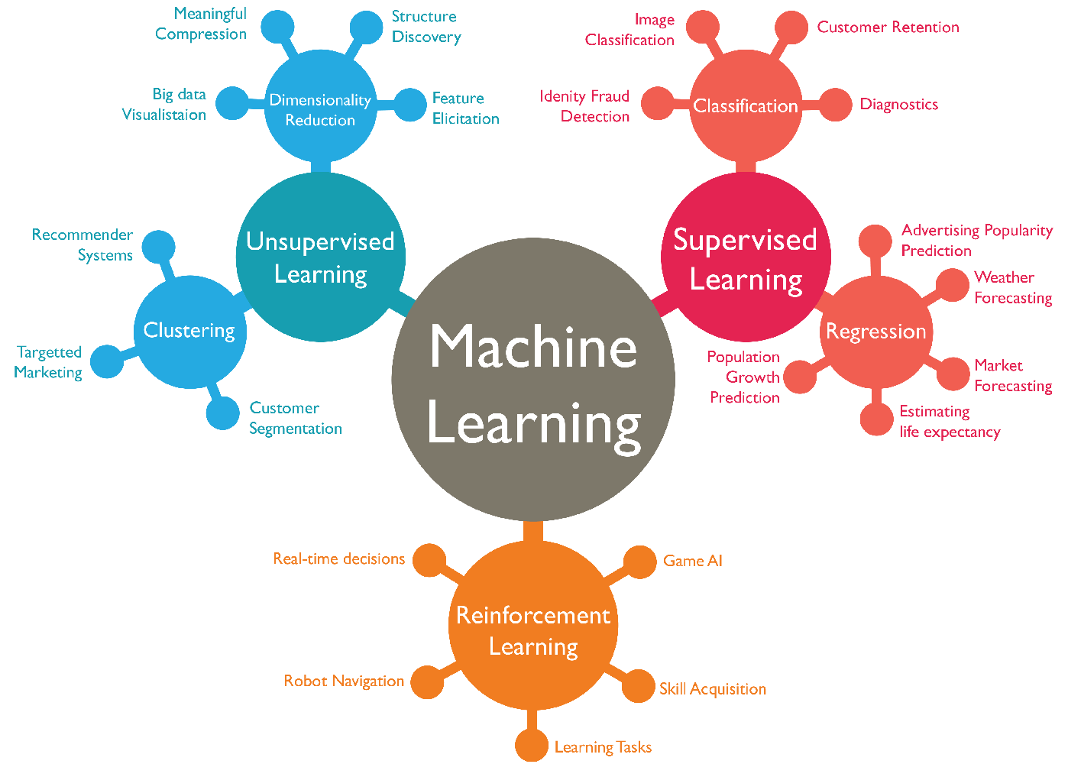
Types of Machine Learning
Arsalan Anwar ©

Slide 9
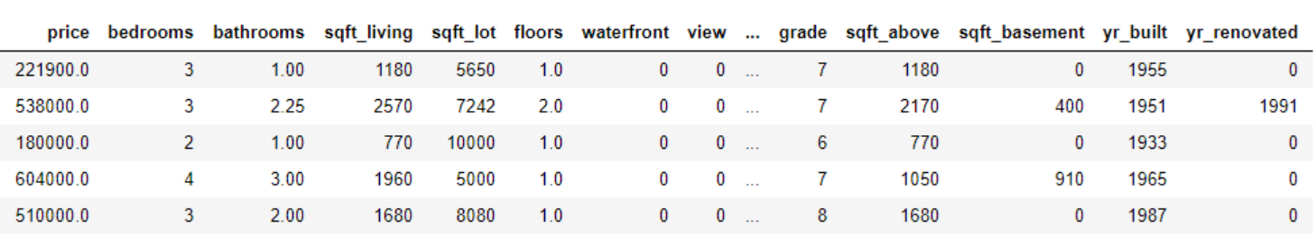
Common ML Terminology
1. Features/ Explanatory variables: The set of variables X that contribute in the prediction of the target variable Y. Ex: bedrooms, bathrooms, sqft_living
2. Dependant/ Target Variable: The variable Y that has to be predicted by the model i.e. the output. Ex: price. General Form: X -> Y
Arsalan Anwar ©

Slide 10
3. Model: A mathematical representation of a real-world process which predicts the future outcome based on training on the past statistics/data
4. Training: The process of creating a model which learns the training data. In simple words, the data is fed to the algorithm which learns a representation for the problem and produces a model
5. Training Set: The dataset used to find potentially predictive relationships that will be used create a model. (70%)
6. Validation Set: The validation dataset provides an unbiased evaluation of a model fit on the training dataset while tuning the model's hyperparameters. (20%)
7. Test Set: The dataset separate from the training dataset which is used to check the performance of the model. This is the dataset which the model has not seen earlier. (10%)
Arsalan Anwar ©

Slide 11
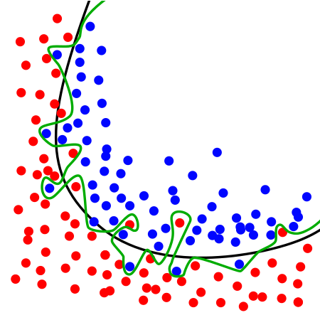
8. Overfitting: Overfitting is "the production of an analysis that corresponds too closely or exactly to a particular set of data and may therefore fail to fit additional data or predict future observations reliably.
Overfitting occurs from high variance and low bias.
9. Underfitting: Underfitting occurs when a statistical model or machine learning algorithm cannot adequately capture the underlying structure of the data. It occurs when the model or algorithm does not fit the data enough.
Underfitting occurs if the model or algorithm shows low variance but high bias.
Overfit Model
Underfit Model
Generalized Model
Class 1
Class 2
Arsalan Anwar ©

Slide 12
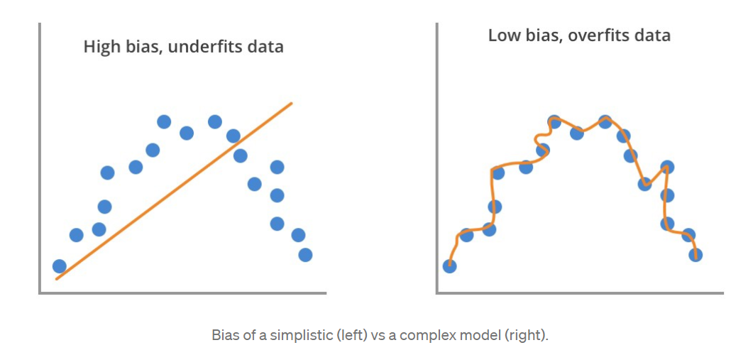
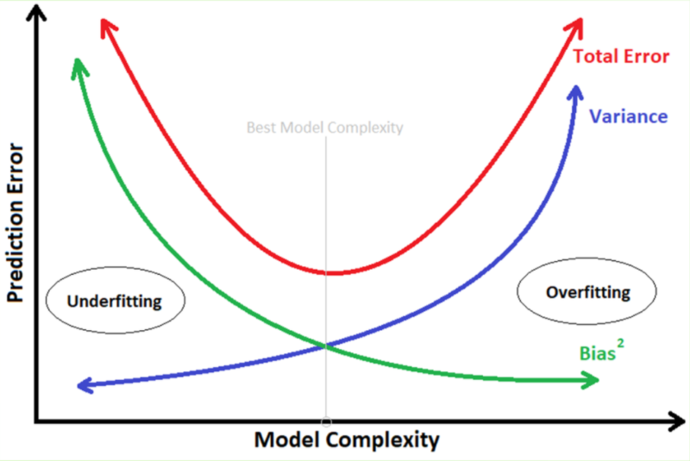
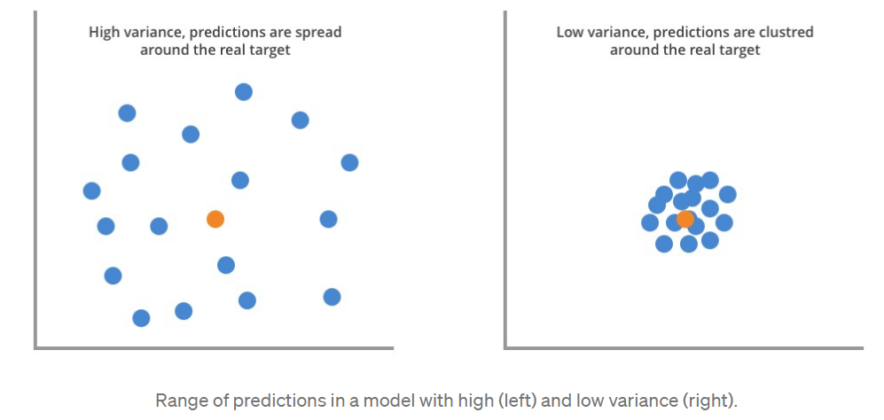
10. Bias: Bias is about the ability to capture the true patterns in the dataset.
11. Variance: Variance captures the range of predictions for each data record.
Generalized Model
Arsalan Anwar ©

Slide 13
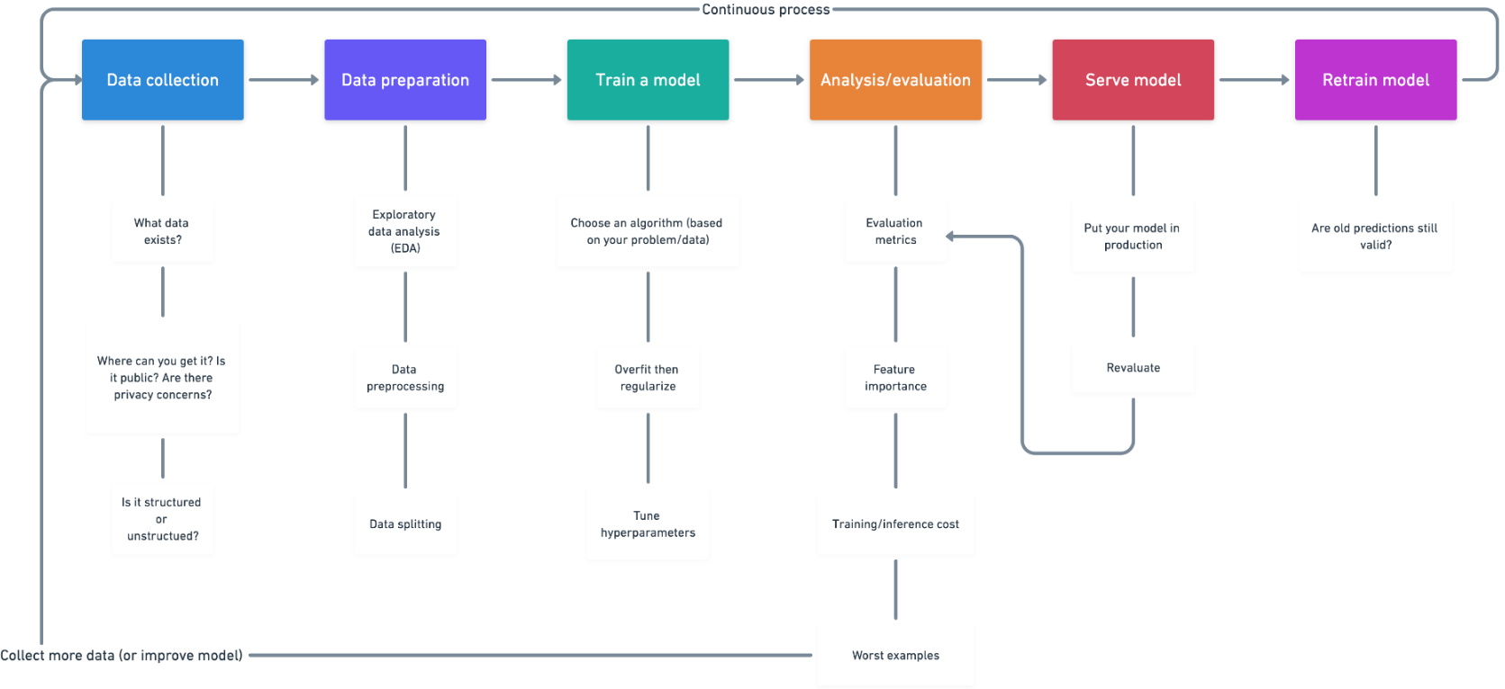
Machine Learning Process
Arsalan Anwar ©

Slide 14
Deep Learning
Deep learning is a branch of machine learning which is completely based on artificial neural networks, as neural network is going to mimic the human brain so deep learning is also a kind of mimic of human brain.
Advantages:
1. Best in-class performance on problems.
2. Reduces need for feature engineering.
3. Eliminates unnecessary costs.
4. Identifies defects easily that are difficult to detect.
Limitations:
1. Large amount of data required.
2. Computationally expensive to train.
Arsalan Anwar ©

Slide 15
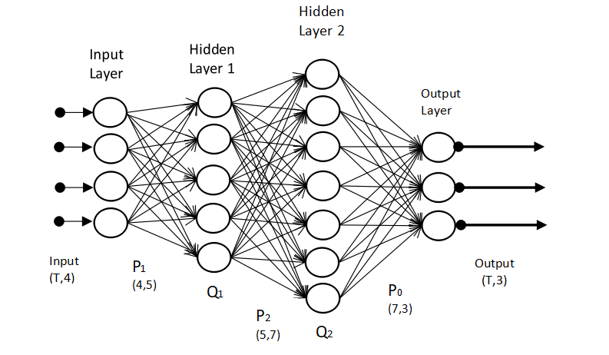
Artificial Neural Network
Artificial neural networks (ANNs), usually simply called neural networks (NNs), are computing systems vaguely inspired by the biological neural networks that constitute animal brains.
An ANN is based on a collection of connected units or nodes called artificial neurons, which loosely model the neurons in a biological brain.
Arsalan Anwar ©

Slide 16
Questions/ Doubts?
Arsalan Anwar ©

Slide 17
Quick Demo
Link to the Example Demo: Fashion Items Classification
Arsalan Anwar ©

Slide 18
Sources
The above content was compiled from various sources such as:
1. Wikipedia
2. Geeks for Geeks
3. Articles/Posts on Towards Data Science
4. Articles/Posts on Medium
5. Youtube
Arsalan Anwar ©

